Slide 1
ABSTRACT
Motion detection technology is integral to a wide range of applications, including security surveillance, human-computer interaction, and automation systems. This project aims to design and implement a robust and efficient motion detection system using advanced algorithms. The primary objective is to develop a system that accurately identifies and responds to motion in diverse environment.
The project employs image processing techniques to enhance detection accuracy and minimize false positives. The methodology involves utilizing OpenCV for recorded video analysis for training motion recognition models. OpenCV is leveraged for its powerful image processing capabilities, enabling the system to efficiently process video frames and detect motion.
The implementation process involves several key steps: data collection, algorithm development, system integration, and testing. Extensive data collection is conducted to create a diverse dataset that includes various types of motion and environmental conditions. This dataset is used to ensure they generalize well to different scenarios. The algorithms are developed to process the detect motion, and display the motion detection.
This documentation provides a comprehensive guide to the design process, algorithm selection, system architecture, implementation challenges, and performance evaluation of the motion detection system. The insights gained from this project contribute to the ongoing research and development in the field of motion detection, offering a foundation for future advancements and innovations.
Keywords: Motion detection, OpenCv2, Python.

Slide 2
INTRODUCTION
1. INTRODUCTION TO MOTION DETECTION
Motion detection refers to the process of sensing physical movement in an environment. This concept is widely used in various fields, from security systems to video processing, robotics, and even home automation. Motion detection technology works by identifying changes in the position of objects relative to a background or monitoring specific movements in a designated area. The methods and techniques used for motion detection have evolved significantly, especially with the rise of digital cameras, image processing algorithms, and sensor technologies.

Slide 3
2.PURPOSE OF MOTION DETECTION
Motion detection serves various critical purposes across different industries and applications. The main objective is to identify or track movement in a given environment or field of view. This capability can be used for monitoring, automation, data analysis, or interaction with dynamic surroundings. Below are some of the key purposes of motion detection:
1. Security and Surveillance
2. Automation and Control Systems
3. Automotive and Transportation

Slide 4
3.PROCESS OF MOTION DETECTION
Motion detection is the process of detecting physical movement in a given space or in a video stream by identifying changes over time. Depending on the method or system used (e.g., cameras, infrared sensors, or other detection technologies), the process can vary. Below is a typical sequence of steps in motion detection, particularly for image-based or video-based systems:
1.Data Collection
2.Preprocessing
3.Triggering Actions

Slide 5
4.APPLICATION OF IMAGE PROCESSING
Image processing has a wide range of applications across many fields. Here’s a clear list of how it's used in different areas:
1.Healthcare
2.Securtity and surveillance
3.Social media and photography
4.Environmental Monitoring and Mapping
5.Banking and Finance
6.Construction and Engineering
7.Textile and Fashion Industry
8.Gaming and Virtual Reality

Slide 6
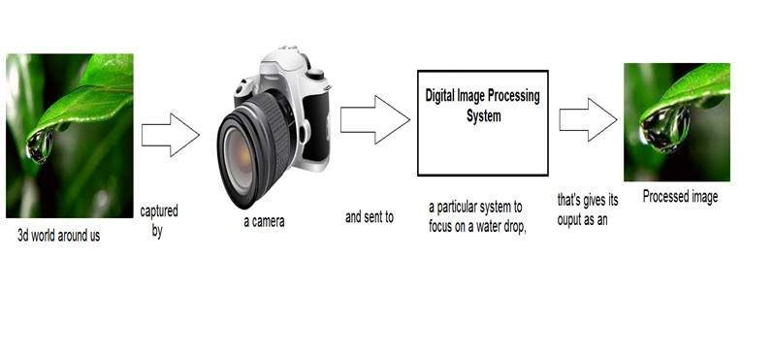
Project Work
1.DIGITAL VIDEO PROCESSING
Digital video processing involves manipulating and analyzing video signals in a digital format. This process is essential for enhancing video quality, compressing data, and enabling various applications across industries, such as entertainment, surveillance, and video conferencing. Below is an overview of digital video processing, including its components, techniques, applications, and challenges.
Fig.digital Video image

Slide 7
2.PROCESSING ON IMAGE
Processing on image can be of three types They are low-level, mid-level, high level.
1. Basic Video Processing
Video Acquisition: Capturing video footage using cameras or sensors.
Pre-Processing: Initial enhancement steps like noise reduction, normalization, and color correction.
2. Compression Techniques
Lossy Compression: Reduces file size by discarding some data (e.g., H.264, H.265).
Lossless Compression: Preserves all data, allowing for perfect reproduction (e.g., FFV1, Logarithm).
3. Video Enhancement
Noise Reduction: Minimizing random noise in video signals.
Color Grading: Adjusting colors for artistic effect or consistency.

Slide 8
3.FUNCTIONS ON APPLIED ON IMAGE
THERE SEVEN TYPES FUNCTIONS IS APPLIED ON IMAGE
1.COLOR IMAGE
2.GRAY SCALE IMAGE
3.THRESHOLDING
4.BACKGROUND SUBTRACTION
5.EROSION
6.DILATION
7.COUNTER DETECTION

Slide 9
1.COLOR IMAGE
It can be spoken to by three capacities, R (xylem) for red, G (xylem) for green and B (xylem) for blue. A picture might be persistent as for the x and y facilitates and furthermore in adequacy. Changing over such a picture to advanced shape requires that the directions and the adequacy to be digitized. Digitizing the facilitates esteems is called inspecting. Digitizing the adequacy esteems is called quantization.
2.GRAY SCALE IMAGE
A gray scale picture is a capacity I (xylem) of the two spatial directions of the picture plane. I(x,y) is the force of the picture force of picture at the point (x, y) on the picture plane. I (xylem) take nonnegative expect the picture is limited by a rectangle.

Slide 10
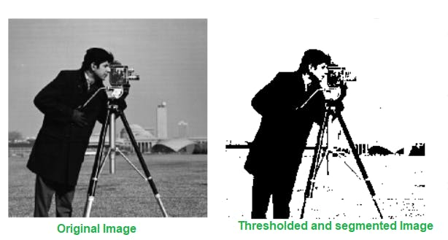
3. Thresholding
Thresholding is a technique used to segment an image by setting all pixel values above a certain threshold to one value (e.g., white) and all pixel values below that threshold to another value (e.g., black). It's commonly used for binary segmentation.
EXAMPLE SIMPLE THRESHOLDING:
INPUT: OUTPUT:

Slide 11
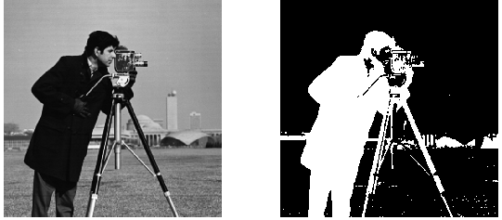
4.Background Subtraction
Background subtraction is used to separate foreground objects from the background. It's commonly used in video processing for motion detection.
EXAMPLE USING MOG2:
INPUT: OUTPUT:

Slide 12
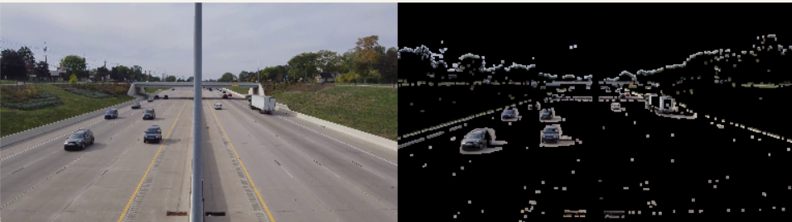
5. EROSION
Erosion is a morphological operation that erodes away the boundaries of the foreground object. It is used to remove small white noises, detach two connected objects, etc.
EXAMPLE USING EROSION:
INPUT: OUTPUT:

Slide 13
4.Challenges and Solutions
Choosing an Appropriate Threshold Value: One of the main challenges in thresholding is selecting an optimal threshold value. If the value is too high or too low, the segmentation may either miss significant data or include noise.
Solutions might include:
Global Thresholding: Methods like Otsu’s algorithm automatically select an optimal threshold by minimizing intra-class variance. It works well for bimodal histograms (where data can be split into two distinct classes).
Adaptive Thresholding: For images with varying lighting or intensity across the scene, adaptive thresholding methods (e.g., Gaussian or mean-based) dynamically compute the threshold based on local pixel neighbourhoods.
Structuring Element Selection: Challenge such as, Choosing an inappropriate structuring element (size and shape) can either over-erode or under-erode the objects, leading to loss of essential features or inadequate noise reduction.

Slide 14
Solutions might include:
Adaptive structuring element: Select a structuring element based on the scale of objects in the image. For example, if objects have different shapes, consider using different structuring elements (e.g., square, disk, cross) or a combination.
Multi-scale erosion: Run erosion at different scales and compare results. This can help in finding the appropriate structuring element size for different objects in the image.
Boundary Handling: Challenge such as, Handling image boundaries can lead to artifacts or errors, such as artificially inflated objects at the edges or boundary loss.
Solutions could include:
Padding Strategies: Use various padding techniques (e.g., zero-padding, wrap-around, or reflection) to properly manage the boundaries.
Border-aware Kernels: Implement kernels that are aware of the boundary, so they adapt dynamically to avoid introducing artifacts.

Slide 15
Moving Background: Challenge such as, Things like trees blowing in the wind or water moving might get confused as "moving objects."
Solutions could include:
Use techniques that can tell the difference between small movements (like leaves) and actual moving objects.
Lighting Changes: Bright or dark conditions can make the counter hard to see.
Solutions could include:
Use techniques to adjust and balance brightness and contrast, so the counter stands out better.

Slide 16
5.TOOL & TECHNOLOGY
1.OpenCv2 (Open Source Computer Vision Library) (Version.2.0):
is an open-source computer vision and machine learning software library. It contains more than 2500 optimized algorithms used for various tasks such as image processing, video capture, and analysis. OpenCV is widely used for real-time computer vision applications.
OpenCV's application areas include:
2D and 3D feature toolkits
Egomotion estimation
Facial recognition system
Gesture recognition
Human–computer interaction (HCI)
Mobile robotics
Motion understanding
Object identification
Segmentation and recognition

Slide 17
2. Numpy (Numerical Python Library):
NumPy is a fundamental package for scientific computing in Python. It provides support for large, multi-dimensional arrays and matrices, along with a collection of mathematical functions to operate on these arrays. In computer vision, NumPy is essential for handling image data, which is often represented as multi-dimensional arrays.
Numpy's application areas include:
Array Creation
Mathematical Operations
Linear Algebra
Random Number Generation
Statistical Analysis
Matrix Operations
Sorting and Searching
Broadcasting
Data I/O (Input/Output)
Image Processing (with libraries like OpenCV)

Slide 18
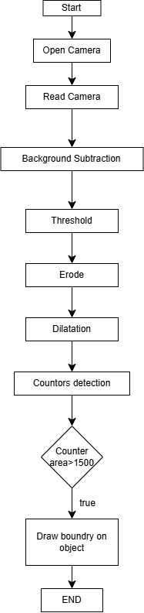
6.Flow Chart

Slide 19
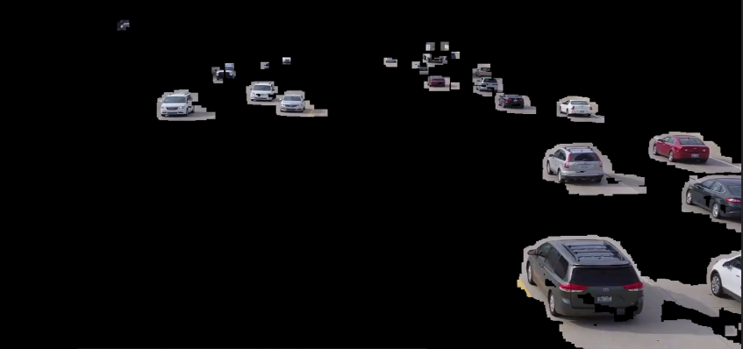
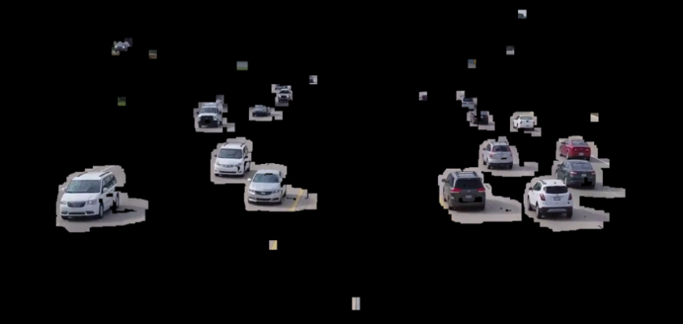
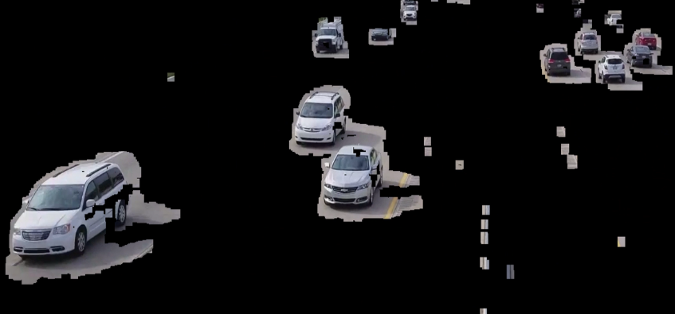
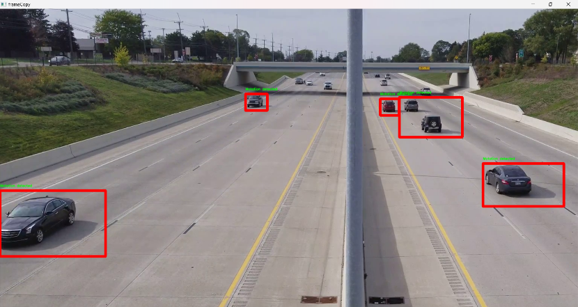
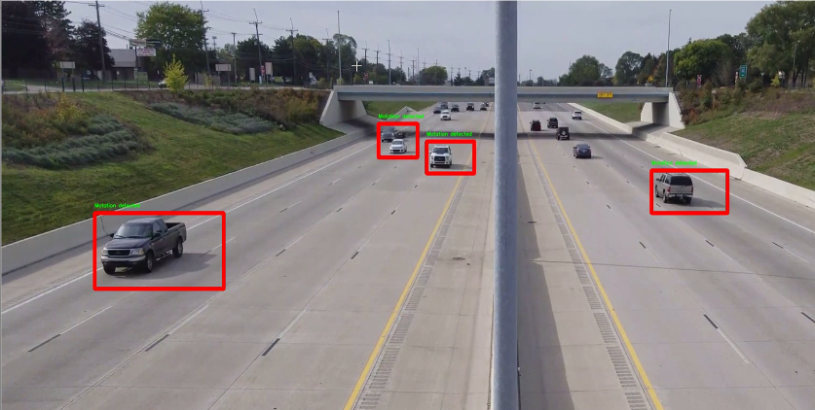
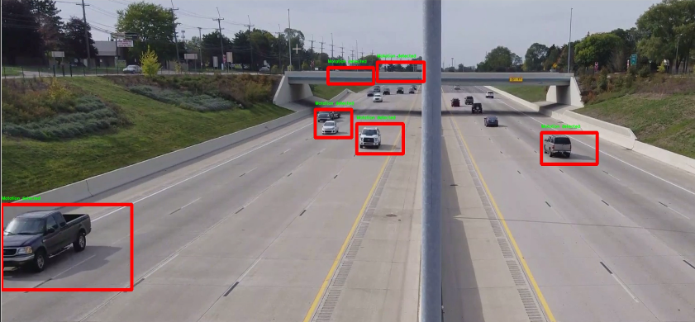
7.OUTPUT IMAGES
EROSION
MOTION DETECTION

Slide 20
Conclusion
Motion detection is a transformative technology that has significantly enhanced various aspects of modern life, from security and surveillance to smart home automation and healthcare. By accurately identifying and tracking movement, motion detection systems provide timely alerts, automate processes, and improve safety and efficiency across diverse applications.
The effectiveness of motion detection lies in its ability to analyze dynamic environments, making it indispensable in areas such as security, where it can prevent unauthorized access and monitor high-risk areas. In healthcare, it aids in patient monitoring and ensures the safety of vulnerable individuals. Additionally, in retail and traffic management, motion detection provides valuable insights into consumer behaviour and vehicle flow, allowing for optimized operations.
As advancements in technology continue to emerge, including artificial intelligence and machine learning, the capabilities of motion detection systems will only grow more sophisticated. This evolution will enable more precise tracking, reduced false alarms, and enhanced integration with other smart technologies, leading to increasingly intelligent environments.
Ultimately, motion detection stands as a vital component of the interconnected world, driving improvements in safety, efficiency, and user experience. Its ongoing development promises to unlock new opportunities and applications, further solidifying its role in shaping the future of technology.

Slide 21
References
List all the references used in the report, including websites, books, and articles.
[1] Ganesan, V., Devi, V. A., & Yellamma, P. (2022). Object Detection using PYTHON Programming. Journal of Next Generation Technology (ISSN: 2583-021X), 2(1).
[2] Sharma, A., Pathak, J., Prakash, M., & Singh, J. N. (2021, December). Object detection using OpenCV and python. In 2021 3rd international conference on advances in computing, communication control and networkmotioning (ICAC3N) (pp. 501-505). IEEE.
[3] “Introduction to detection” ,Available at:
https://www.geeksforgeeks.org/opencv-python-tutorial/
[4] “tutorial of Motion detection” ,Available at: https://youtu.be/oXlwWbU8l2o?si=PDhdeqCzorR88Eg0
[5] Jalled, F., & Voronkov, I. (2016). Object detection using image processing. arXiv preprint arXiv:1611.07791.
[6] Joshi, P. (2015). OpenCV with Python by example. Packt Publishing Ltd.
[7] Mordvintsev, A., & Abid, K. (2014). Opencv-python tutorials documentation. Obtenido de https://media. readthedocs. org/pdf/opencv-python-tutroals/latest/opencv-python-tutroals. pdf.
[8] “simplification of object detection”, Avaliable at:http://www.kaggle.com/

